Slide 1

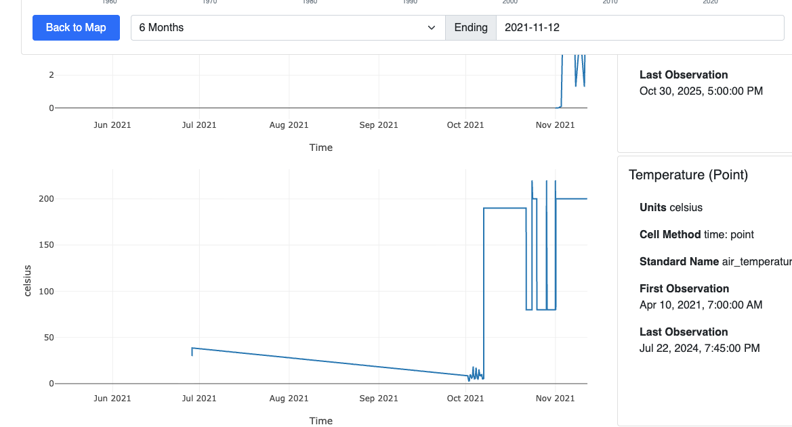
15130 | 657
air_temperature_point,Duncan River below B.B. Creek 2,DBC2,13214,1520294008,2021-10-18 07:00:00.000000,2026-02-04 14:23:08.736102,190,657,15130,tongli1997
Replaced by DBC2 - move data record, delete station | 5 | BCH-GSO-HMP | DBC -> DBC2 | 2452 | Duncan R. blw BB Ck -> Duncan River Below Blue Berry Creek 2

Slide 2
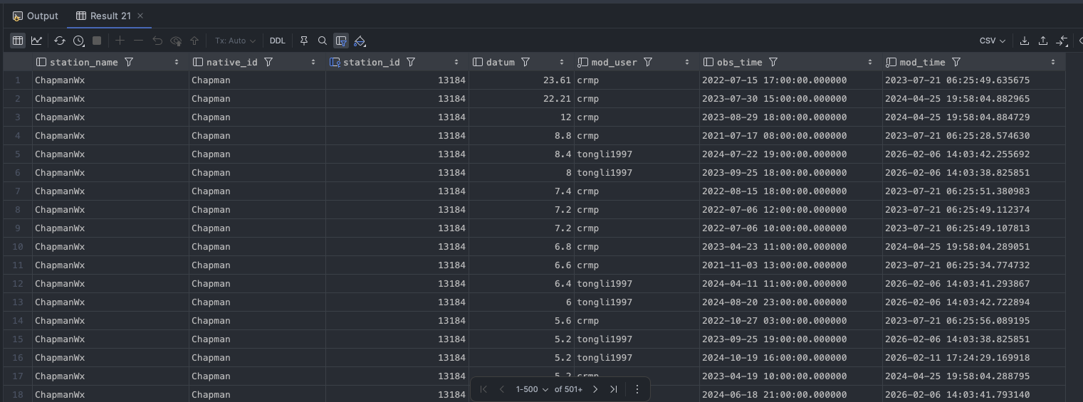
15106 | 501
833
Both Insert new station

Slide 3
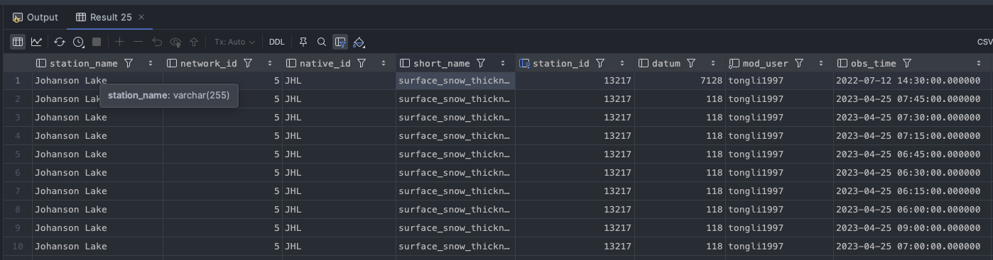
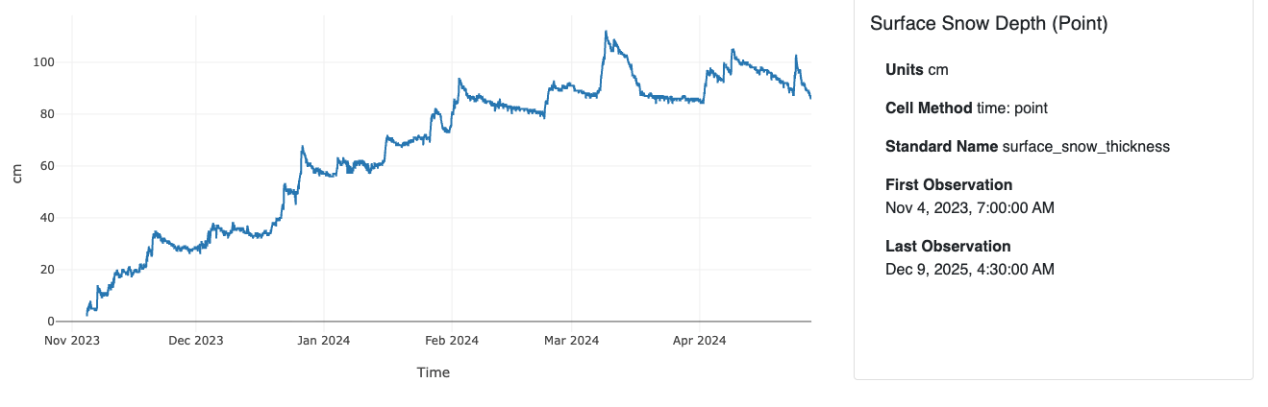
h.history_id = 15133 and v.vars_id = 468
Concatenate data with 13217, then delete | 5 | BCH-GSO-HMP | JHL | 13128
This is the correct station to use | 5 | BCH-GSO-HMP | JHL | 13217 | Johanson Lake

Slide 4
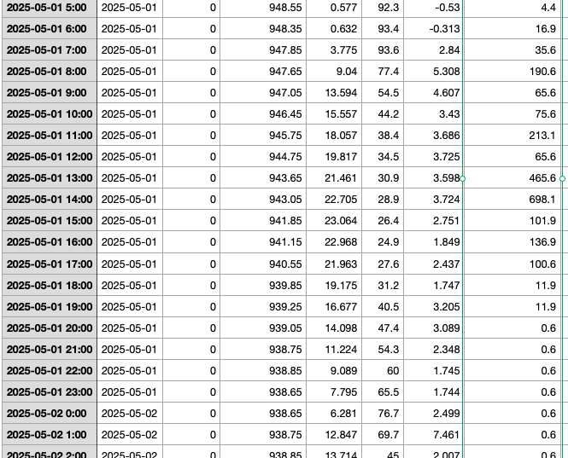
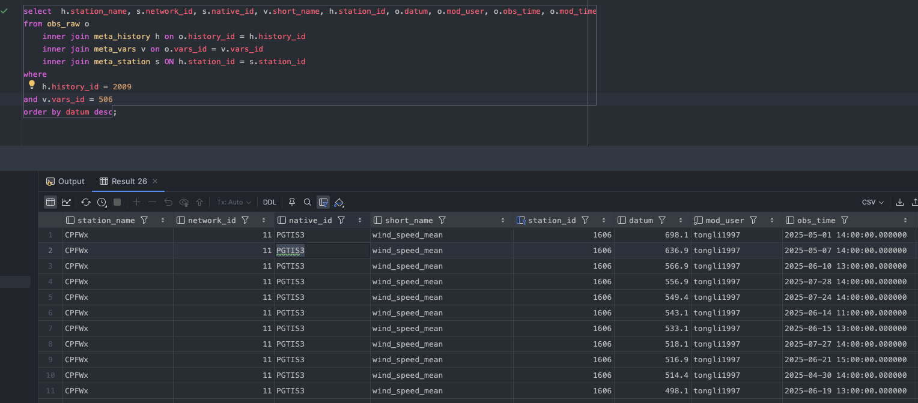
Fern new data insert

Slide 5
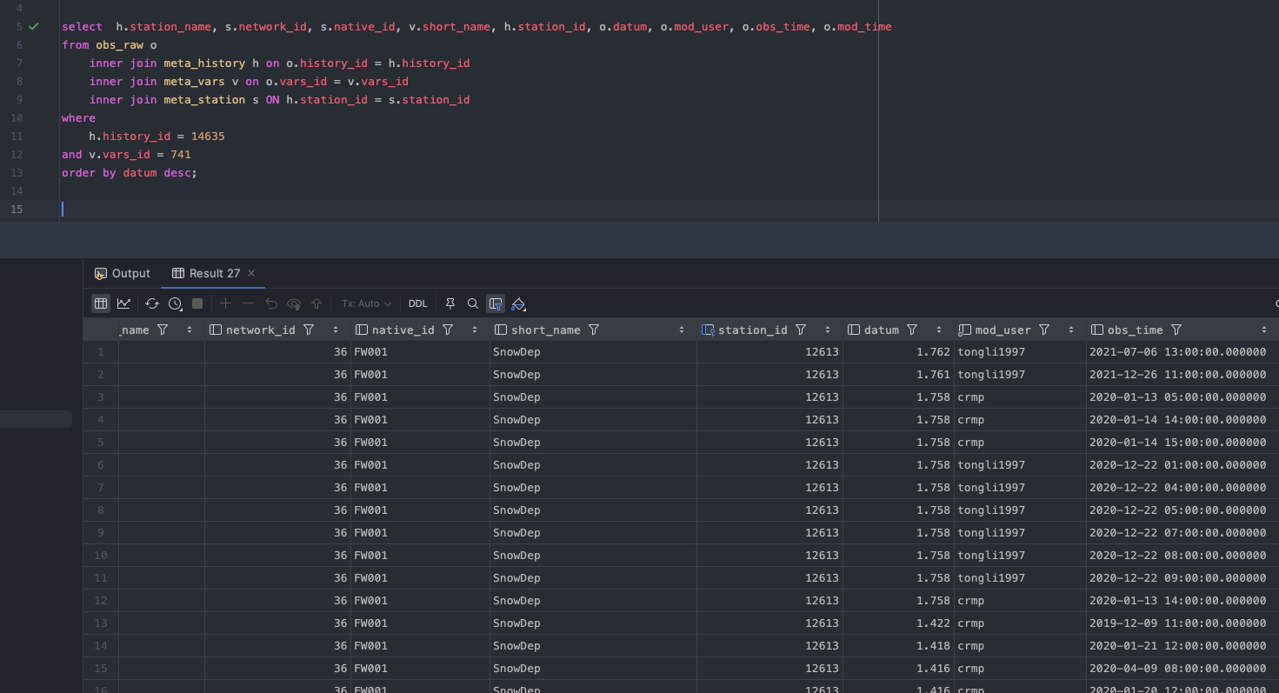
Looks normal
Concatenate data and Delete this station | 36 | CRD-WS | 14g -> FW001 | 12627

Slide 6
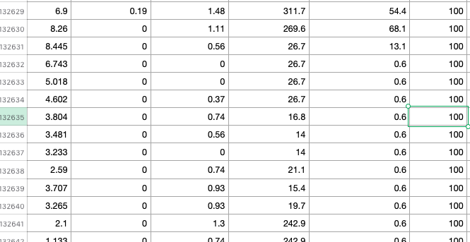
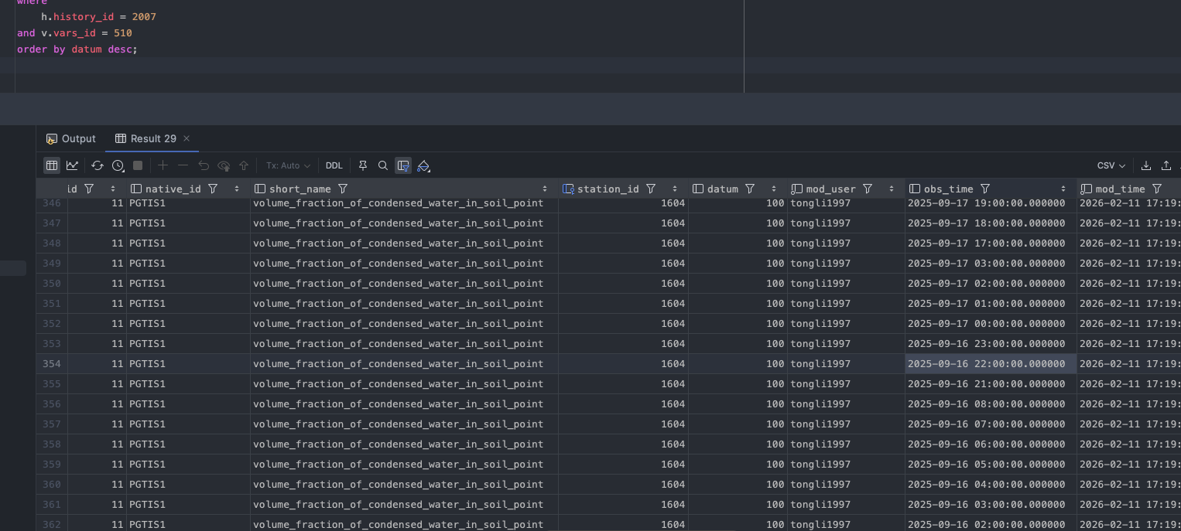
New station insert

Slide 7
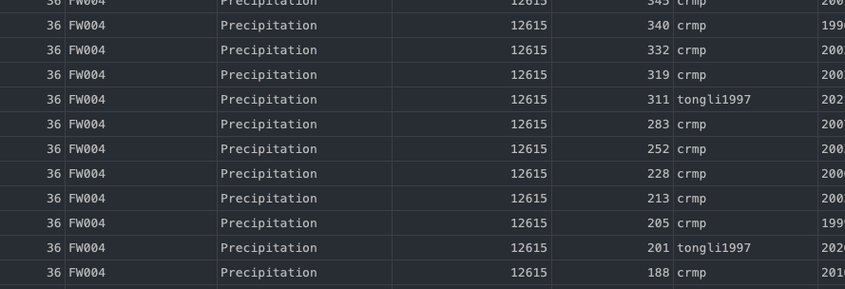
h.history_id = 14637 and v.vars_id = 738
Concatenate data and Delete this station | 36 | CRD-WS | 4rw6 -> FW004

Slide 8
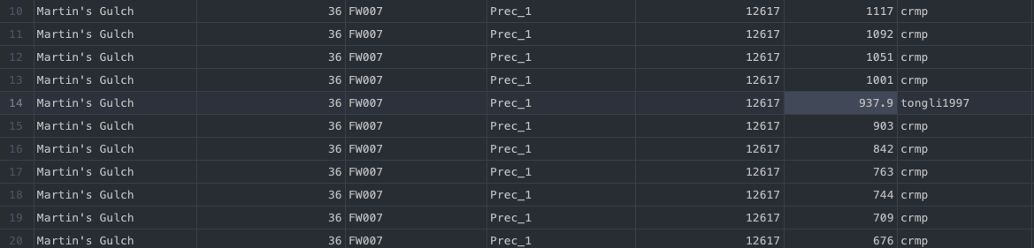
14639 | 738 | Martin's Gulch | Prec_1 | 97144 | 43851 | 0.0108 | 0.0611 | 0.0503
Concatenate data and Delete this station | 36 | CRD-WS | martins_gulch -> FW007

Slide 9
When new data arrive:
Import into the PCDS raw pool.
Perform quality control (QC).
If data pass QC → standardize variable names → move to Good Data Pool.
If data fail QC → remain in PCDS raw pool for further review.
QC Frequency
Option 1: Immediately after data import (recommended).
Option 2: Scheduled (e.g., daily or monthly batch QC).
To be determined based on operational needs.
Periodic Re-evaluation
Conduct regular scans of the PCDS raw pool.
If previously flagged data become complete or consistent as new data arrive → move to Good Data Pool.
Good data (purred)
Standardize
(consistent var_name etc,…)
Good data (original)
?
Quality control (QC)
PCDS raw pool

